Slide 1

Inside Sherpa – Digital Internship
Technology, Strategy & Architecture – Technology Optimisation & Delivery Module

Slide 2

Inside Sherpa – Digital Internship
Who plays in the market (short longlist)
Financial Accounting service offering
Operations and Support in Australia
Company fundamentals and depth of market presence
Time in operation and history
Financial position and performance
Credibility of ownership and leadership
Scale
Reputation
Proven experience in Financial Accounting System
Client base
Experience and clients delivering similar services (SaaS)
Relevant projects of similar scope and scale
Scope of Service
Financial Accounting system functions and capabilities
Additional service offerings such as Payroll and Expense Management System
Ease of Integration with Salesforce
Reporting capabilities
Long term vision, technology alignment and innovation
Native Cloud Application
Supports API capabilities
Strong investment in R&D and innovation
Technology, Strategy & Architecture – Technology Optimisation & Delivery Module

Slide 3








Provider (by Order of Assessment) |  | Rationale for Inclusion
Oracle (NETSUITE) |  | NetSuite Inc. was an American cloud computing company founded in 1998 with headquarters in San Mateo, California that provides software and services to manage business finances, operations, and customer relations. Its software and services are tailored for small, medium-sized and large businesses with modules for ERP,
SAGE Live |  | For owner-run organizations with professionals or small teams responsible for finance, looking to reduce admin, take care of accounting and increase profits.
Microsoft Dynamics 365 |  | Dynamics 365 is sold in two editions, the Business Edition for small and medium-sized enterprises (SMEs or SMBs), and the Enterprise Edition for medium to large organizations. The Business Edition includes the Financials application, based on the project code-named 'Madeira'. The Enterprise Edition comprises Dynamics CRM applications (field service, sales, project service automation, and customer service)
FinancialForce |  | A cloud computing platform from salesforce.com.FinancialForce supplies Accounting, Billing, Professional Services Automation (PSA), Revenue recognition, Human Capital Management (HCM), and Supply Chain Management (SCM) applications.
MYOB Advanced |  | MYOB has a suite of subscription-based products and a browser-based accounting product that was released in August 2010. On 24 October 2012, MYOB released AccountRight Live an update to its flagship product - a Microsoft Windows only software suite which has online storage of data.
Oracle ERP Cloud |  | Oracle Enterprise Resource Planning Cloud is a cloud-based software application suite introduced by Oracle Corporation in 2012. Oracle ERP Cloud manages enterprise functions including accounting, financial management, project management, and procurement.
Workday Financials |  | Bring your accounting, consolidation, procurement, projects, reporting, and analytics into one financial management system. Cloud ERP software from Workday gives you unparalleled insight and a state-of-the-art foundation for transactional efficiency and control.
Epicore |  | Epicor also released the plan 'Fit for the Future,' intended to support stakeholders in the group develop market sustainability and thrive in the new environment. Providers involve resellers, device integrators, and business partners who can use the Epicor software range and services to introduce, plan, and build transformational IT strategies.

Slide 4
Scope of Service - Capability Assessment
Initial assessment of each provides demonstrated capability to deliver specific services related to the scope of work
Service Capabilities
Provider | Core Financial Functions | Deferred Revenue | Payroll and Expense Management System | Reporting Capabilities | API based integration Capabilities | Native Cloud
 | √ | √ | √ | √ | √ | √
 | ~ | ~ | ~ | ~ | ~ | ~
 | √ | √ | √ | √ | √ | √
 | √ | √ | √ | √ | √ | √
 | ~ | ~ | ~ | ~ | ~ | ~
 | √ | √ | √ | √ | √ | x
 | √ | √ | √ | √ | √ | √
 | √ | x | √ | ~ | √ | x
√
~
x
Limited evidence of alignment to requirements
Strong evidence of alignment to requirements
Moderate evidence of alignment to requirements
Source(s): Company website
Please note the above is indicative only

Slide 5
Initial Market Scan Results |
Based on the current research, the following are Sector Metrics assessment of the market longlist against the attributes. Rating are subject to change based on further assessment.
Provider | Company Fundamentals |  | Proven Experience | Scope of Services | Vision and Culture | Comment
 |  |  |  |  |  | Strong evidence of alignment to key requirements, including dedicated Australian support and partner with Tier 1 Payroll and Expense Management Systems
 |  |  |  |  |  | NA
 |  |  |  |  |  | NA
 |  |  |  |  |  | NA
 |  |  |  |  |  | MYOB opted out of accounting system vendor evaluation process due to tight Solution Review Workshops deadline
 |  |  |  |  |  | NA
 |  |  |  |  |  | NA
 |  |  |  |  |  | NA
Strong evidence of alignment to requirements
Moderate evidence of alignment to requirements
Limited evidence of alignment to requirements
Insufficient data to score at this point in time

Slide 6

Targeted Vendors for Further Assessment
The following is a list of vendors targeted for further assessment.
Next Steps
RFP sent to vendors – The RFP detailing the functional requirements and use cases for the New FAS to be sent to the shortlisted vendors.
Solution Review Workshop Session – The shortlisted vendors will be invited to discuss their submission and showcase their solution capability.
Vendor Evaluation – Define scoring sheet and evaluate each vendor on their product offering, using cases solution and delivery capabilities.
Commercials and Contract Negotiation – Vendors will be requested to provide their licencing, implementation and ongoing maintenance costs for reviewed and negotiation.
Strong evidence of alignment to requirements
Moderate evidence of alignment to requirements
Limited evidence of alignment to requirements
Insufficient data to score at this point in time

Slide 7
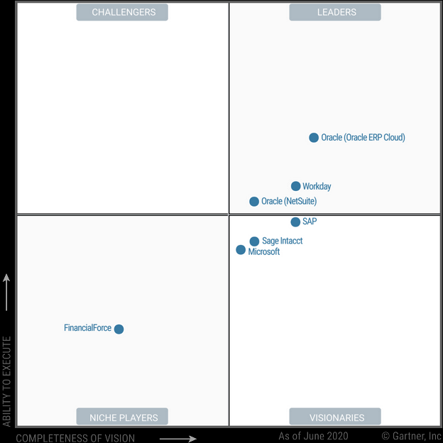
Leaders in Industry comparison

